Slide 1
Decoding Music Genres Through Physical Acoustic Features
Student Name: Li Yuan
Student ID: 21234252

Slide 2
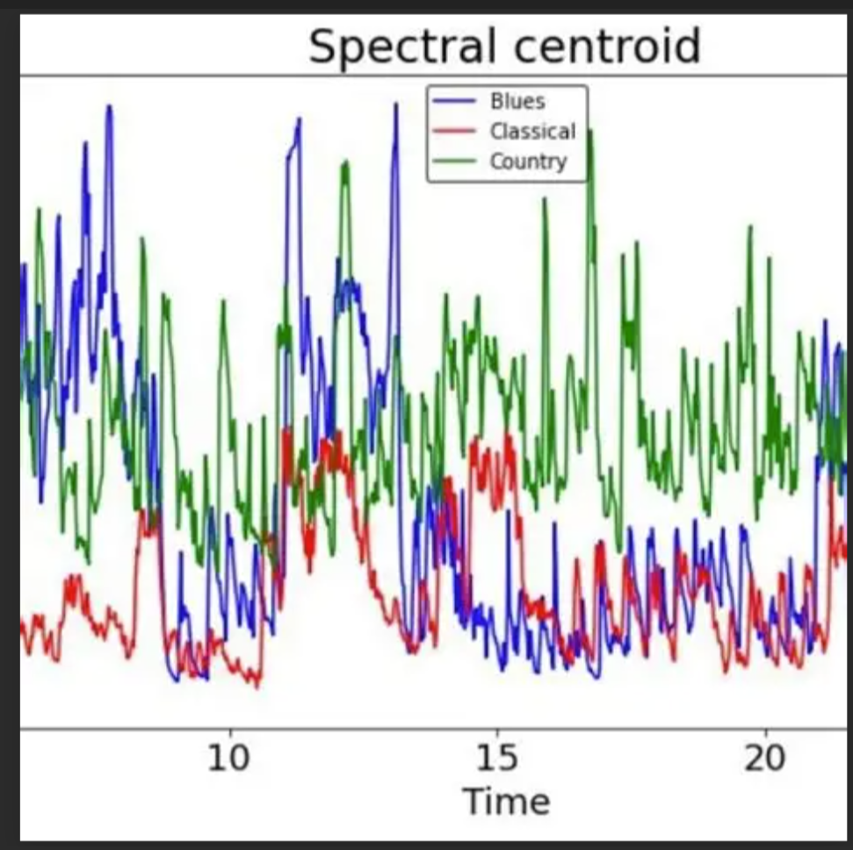
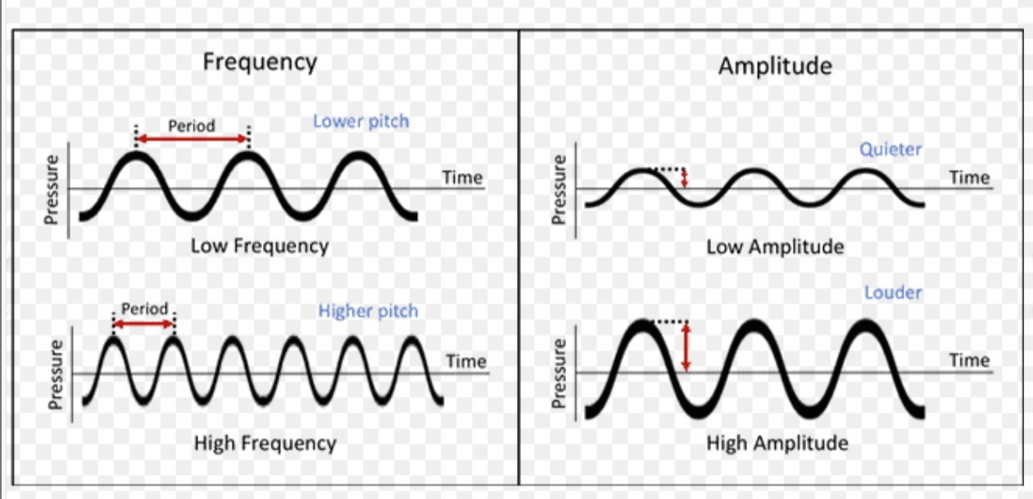
Introduction:
Physical acoustics with digital audio signals
Sound, as a mechanical wave
It can be quantified into computable audio features
sound sharpness / brightness

Slide 3
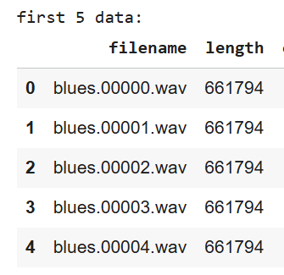
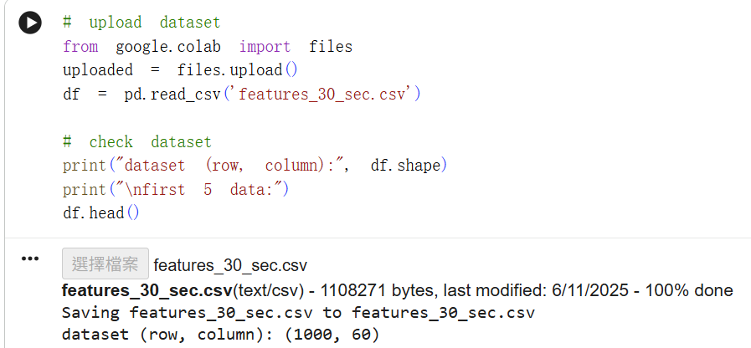
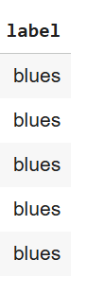
Dataset:

Slide 4
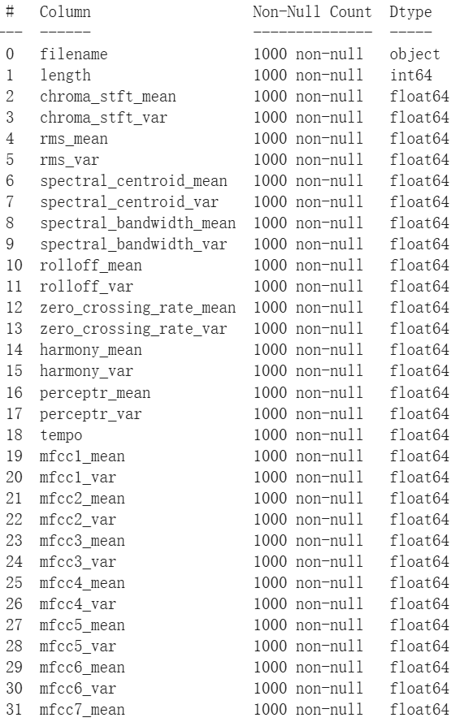
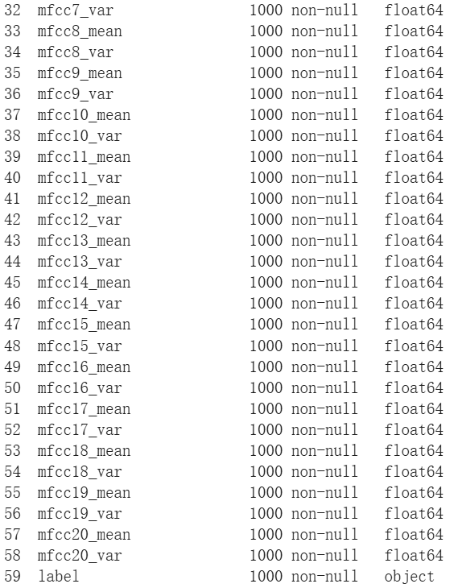
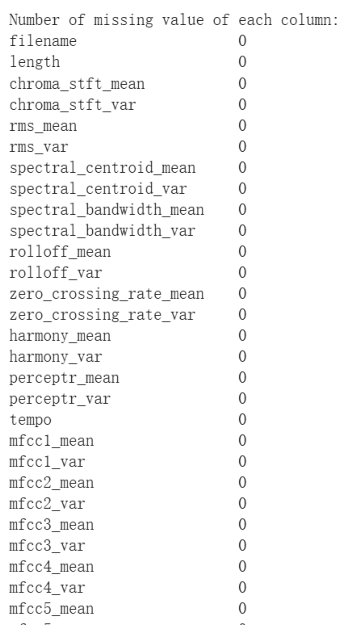
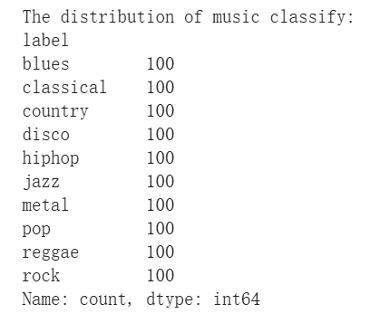
Dataset:
Only ‘tempo’ no mean and variance column

Slide 5
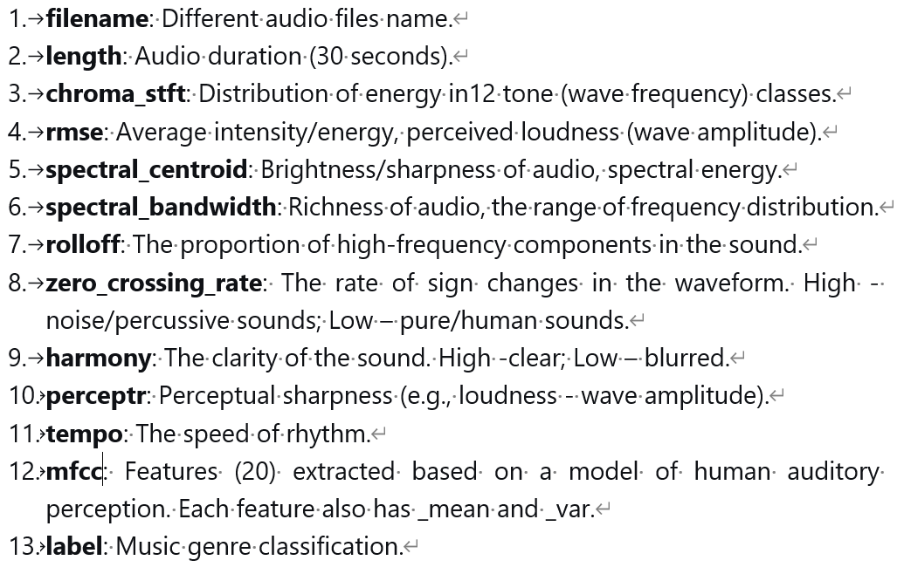
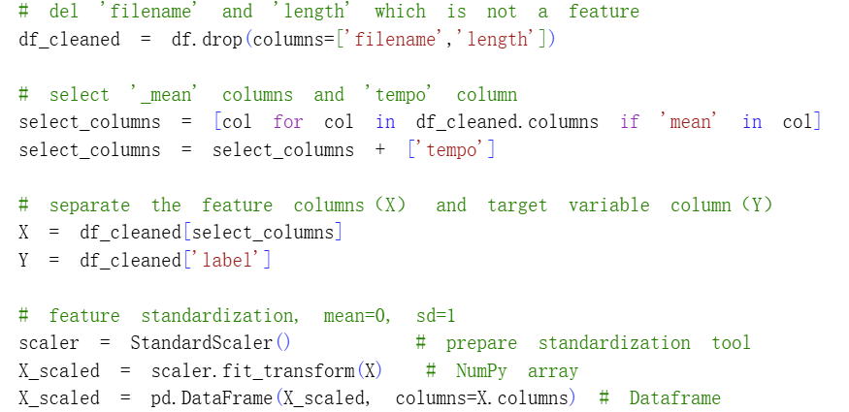
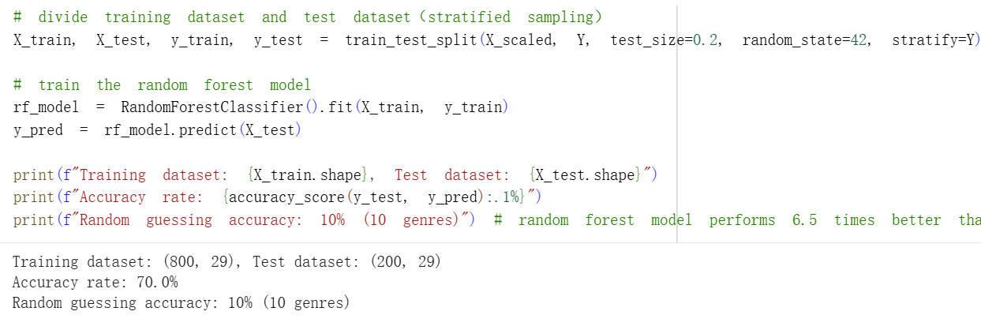
Dataset:

Slide 6
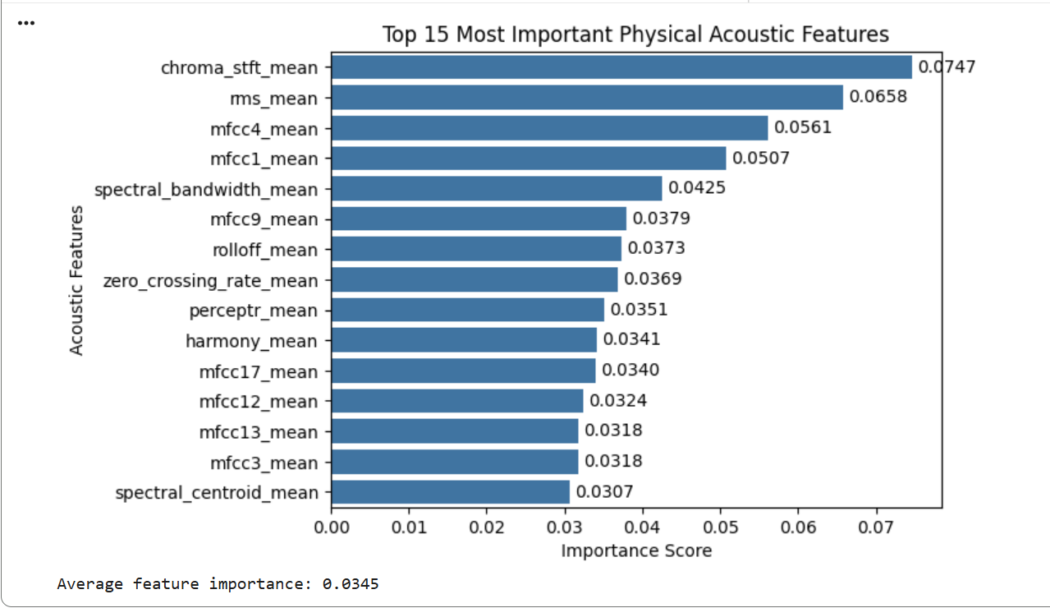
First Chart:
Tool: Random Forest classifier and bar chart
Target: Obtain important scores for each feature in determining music type
energy distribution
approximately 2 times the average value
Insight: Reflect that different types of music may exhibit differences in the distribution of high frequency energy.

Slide 7
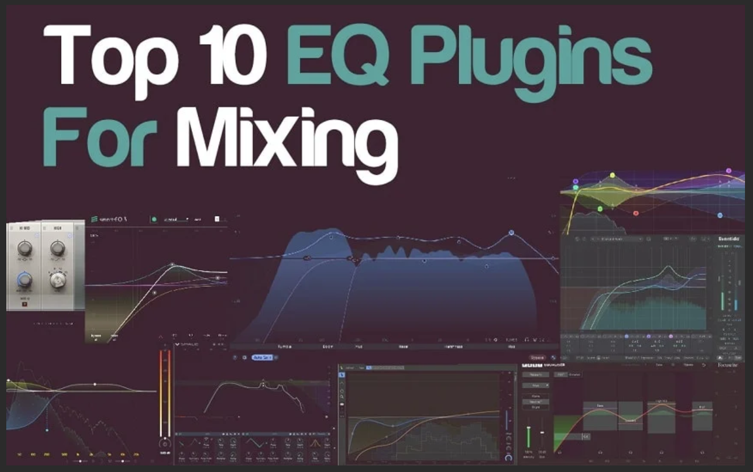
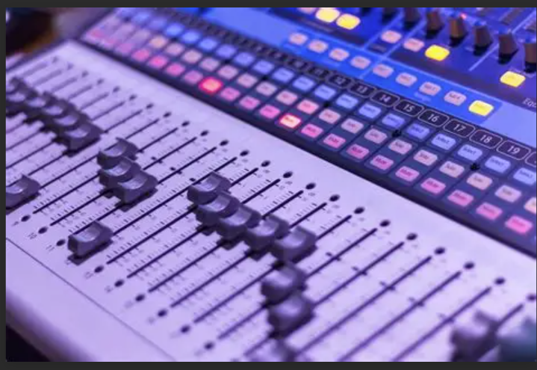
Action Recommendations :
smart mixing plugins
equalizer and compressor parameter settings

Slide 8
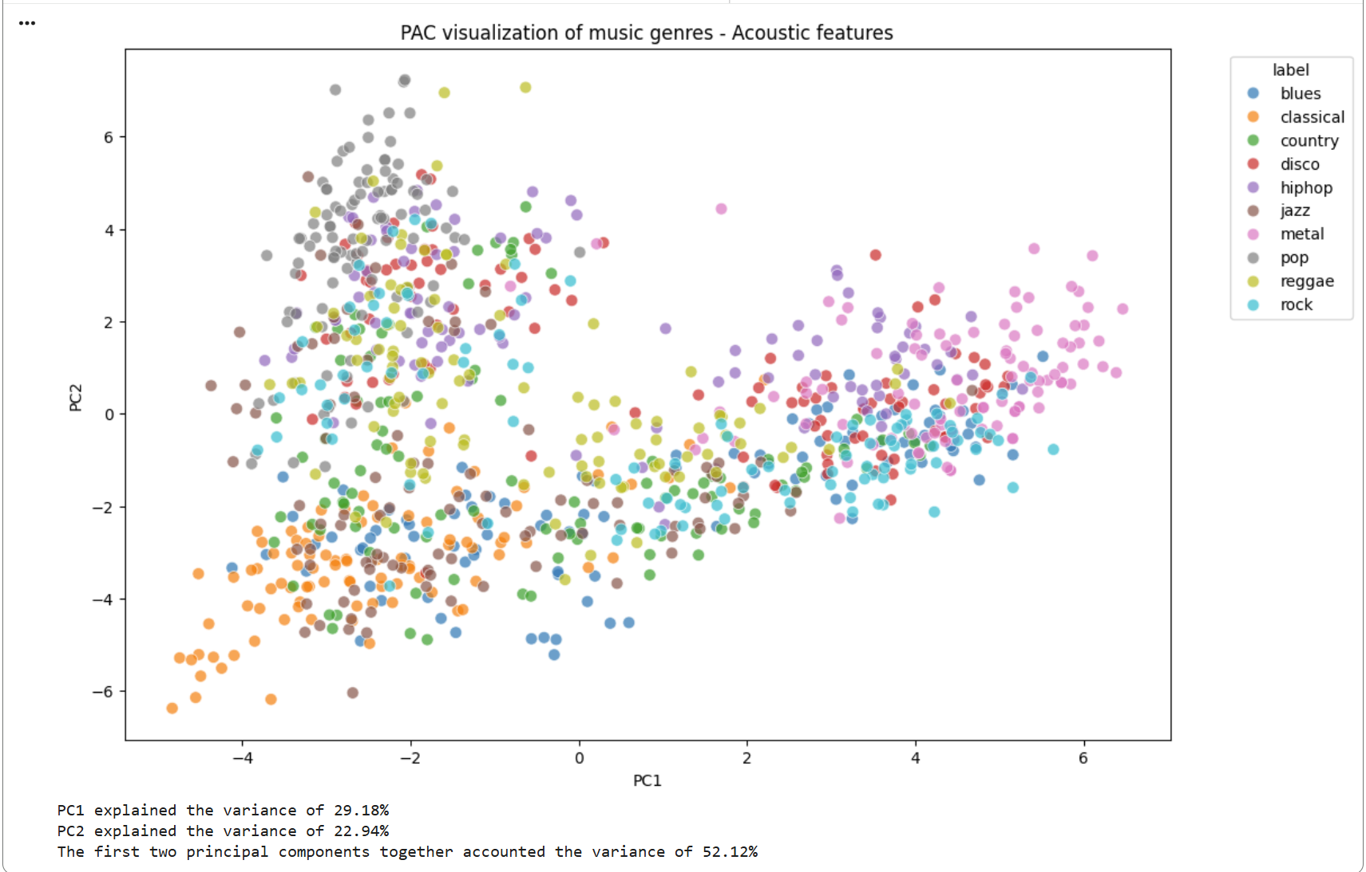
Second Chart:
Tool: PCA and scatter plots
Target: Analyze music type clustering
Insight: Shows clear structural separation between music types in the acoustic feature space.
And adjacent clusters reflect similar acoustic properties and musical styles.
explain half of the variation in original data

Slide 9

Action Recommendations :
music recommendation

Slide 10
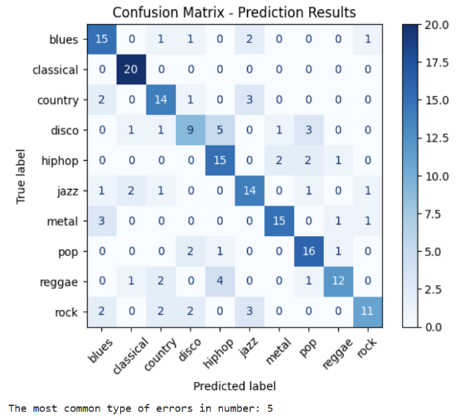
Third Chart:
Tool: Confusion matrix
Target: Identify frequent misclassification patterns
Insight: Music types that are easily confused have relatively high acoustic similarity.
0 error: shows its uniqueness of acoustic features

Slide 11
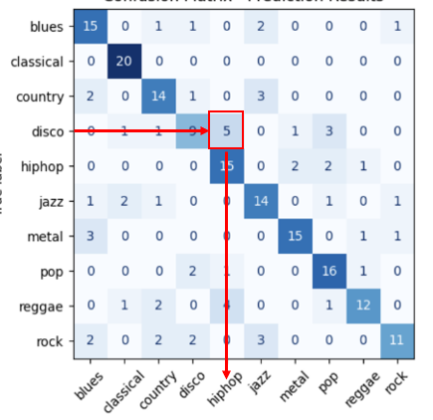
Action Recommendations :
stylistic fusion
Easy to fusion
Challenge to fusion

Slide 12
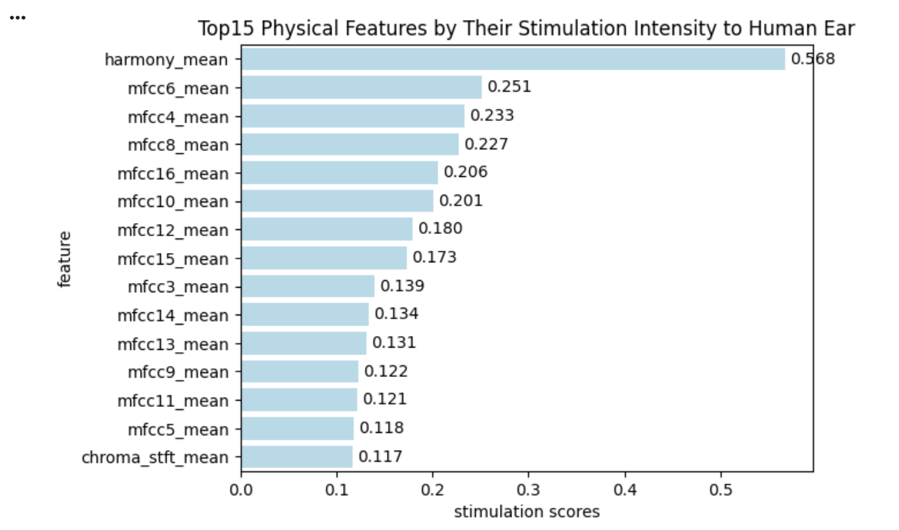
Fourth Chart:
Tool: Correlation analysis and bar charts
Target: Evaluate how acoustic features stimulate human hearing
the highest r value
Insight: Reflect that “harmony” is the dominant acoustic factor to determine sound stimulation levels and can control reactions from the human ear.

Slide 13

Action Recommendations :
create atmosphere
reduce 'harmony’ to create tension or startling effects
horror movies

Slide 14
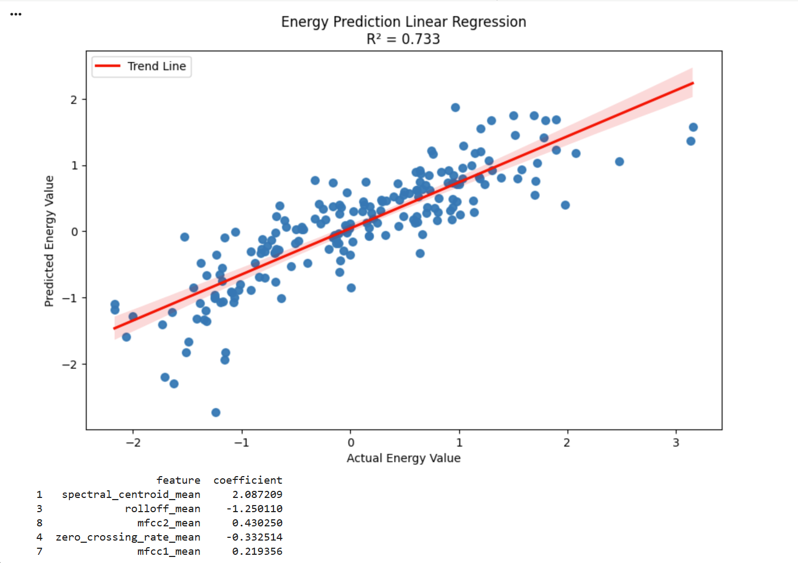
Fifth Chart:
prediction accuracy
Tool: Multiple linear regression
Target: Analyze sound wave energy distribution
Insight: It can be easier to measure sound energy level just by a few key features
sound brightness or sharpness
strong positive correlation
strong negative correlation

Slide 15



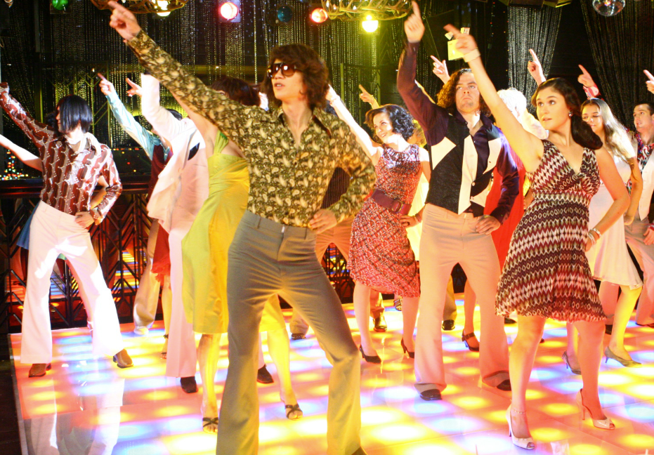
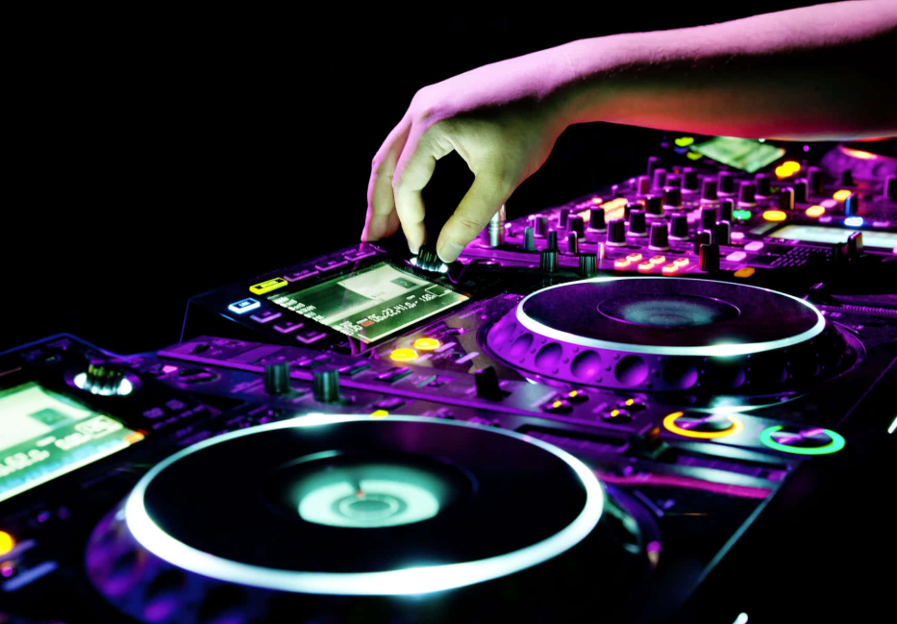
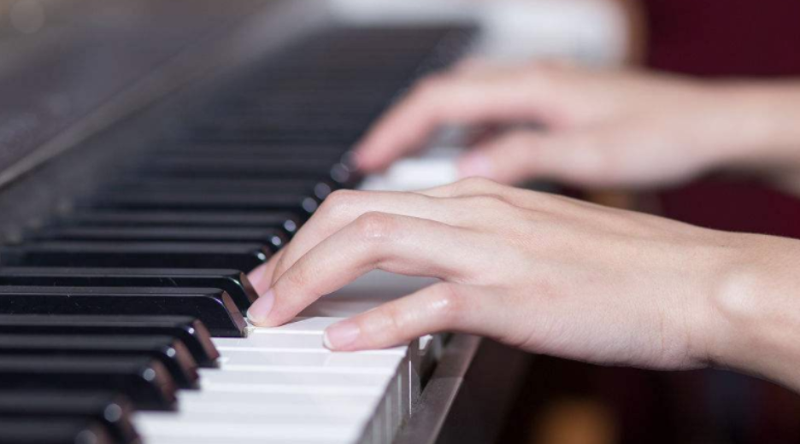
Action Recommendations :
Recommend music through energy
Working: concentrate
(low-energy ambience/pure music)
waking up: activate
(medium-energy disco)
Exercising: power
(high-energy electronic music)

Slide 16
Conclusion:
The project can enhance accurate understand and creation of music through physical features.

